Slide 1
Maximum Expenditures for the nineteenth Financial Period (2024-2027)
76th Session of the Executive Council
EC-76/Doc. 5 and EC-76/INF. 5
27 February 2023

Slide 2




WMO Strategic Plan 2030
Vision
A world where all nations, especially the most vulnerable, are more resilient to the
socioeconomic impact of extreme weather, climate, water and other environmental events, and
empowered to boost their sustainable development through the best possible weather, climate and water services
Overarching Priorities
Preparedness for, and reducing loss of life, infrastructure and livelihood from hydrometeorological extremes
Climate-smart decision-making
to build resilience and adaptation to climate risk
Socioeconomic value
of weather, climate, hydrological and related environmental services
Core Values
Accountability for results
and transparency
Collaboration and partnership
Inclusiveness and diversity
1
3
Member Services
Close the
capacity gap
5
Services
Better serve
societal needs
Infrastructures
Enhance Earth system observations and predictions
Science and Innovations
Advance targeted research
Smart
Organization
Strategic realignment of WMO structure and programmes
Long-term Goals
2
4
Strategic Objectives
Focus areas for
2024-2027 ⇣
National multi-hazard early warning/alert systems
Policy- and decision-supporting climate information & services
Hydrological services
Decision-supporting weather information & services
Changes in the cryosphere and downstream impacts
Acquisition of Earth system observation data (WIGOS)
Access to, exchange and management of Earth system observation data and products (WIS)
Access to and use of numerical analysis and Earth system prediction products
Advance scientific knowledge of the Earth system
Enhance science-for-service value chain to improve predictive capabilities and analysis
Advance policy-relevant science
Enable developing countries to provide and utilize essential services
Develop and sustain core competencies and expertise
Scale up partnerships for investment in sustainable cost- efficient infrastructure and service delivery
Optimize WMO constituent body structure
Strategic partnerships
Advance equal, effective and inclusive participation
Environmental sustainability

Slide 3
WMO STRATEGIC PLAN
OVERARCHING PRIORITIES
2020–2023:
LAYING THE GROUND
2024–2027
SCALING UP
Enhancing preparedness and reducing loss of life, critical infrastructure and livelihood from hydrometeorological extremes
Supporting climate-smart decision making to build or enhance adaptive capacity or resilience to climate risk
Enhancing socioeconomic value of weather, climate, hydrological and related environmental services
Early Warning Systems for All
Global Greenhouse Gas Monitoring Infrastructure
WMO Vision and Strategy for Hydrology + Plan of Action
Action on changes in the cryosphere and downstream impacts on water resources and sea level rise
Reorganization and optimization of WMO Regional and Representative Offices

Slide 4
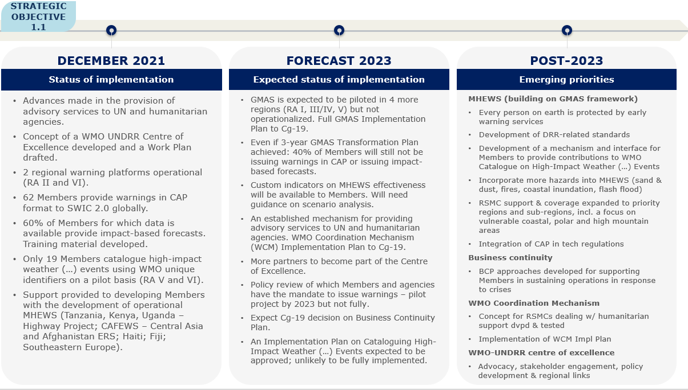
Basis for WMO Strategic Plan 2024-2027
  Regional priorities
  New policies & strategies (e.g. Unified Data Policy, WMO Vision and Strategy for Hydrology)
  Updates to technical strategies (e.g. Services Delivery, Capacity Development, GMAS)
  Data from WMO Monitoring System (KPIs, Performance Assessment Report 2020-2021)

Slide 5







LONG-TERM GOAL 1. BETTER SERVE SOCIETAL NEEDS:
delivering authoritative, accessible, user-oriented and fit-for-purpose information and services
Impact
STRATEGIC OBJECTIVE 1.1: Strengthen national multi-hazard early warning/alert systems and extend reach to better enable an effective response to the associated risks
Outcome
FOCUS AREA/OUTCOME A:
FOCUS AREA/OUTCOME B:
FOCUS AREA/OUTCOME C:
Better preparedness, response to and recovery from environment-related hazardous events
Enhanced impact- and risk-based extended forecast and warning products and services
Enhanced access to official national environment-related forecasts and warnings globally in support of regional and global requirements across all time scales
Intermediary outcomes
Policy & institutional development
Technical development
Global/regional uptake
WMO Cataloguing of Hazardous Events connected to loss and damage reporting systems
Atlas on mortality updated and input to the United Nations Framework Convention on Climate Change (UNFCCC) reporting
WMO-United Nations Office for Disaster Risk Reduction (UNDRR) centre of excellence delivers according to workplan
Business Continuity Plan on responses to crises and sustained operations of the Multi-hazard Early Warning Systems (MHEW) services
WMO register of alerting authorities maintained/updated
Regulations on warnings authority developed
Members’ capacities enhanced through guidance, training and product development on:
Cataloguing high-impact events
impact-based forecasting and warning services on multiple timescales (up to extended timescales) for all vulnerable areas, including polar and high-mountain regions
Development of probabilistic forecasts using data from global producing centres
Technical support on main hazards
DRR-related standards developed, including for QMS and personnel competencies for EWS
CAP integrated in technical regulations
GMAS fully operational
Communities of Practices built
Country risk profiles maintained
WCM implemented
Members’ warnings available, aggregated and visualized through the Severe Weather Information Centre (SWIC) and other existing platforms and warning mechanisms leveraged by the GMAS framework
Strengthened country user interface platforms
*
Outputs
Legend:
Early Warning
Early Action
Climate adaptation &
GHG Monitoring
Water
Ambitions
Legislation & socio-econ
omic benefit analysis
*
Capacity
Development

Slide 6
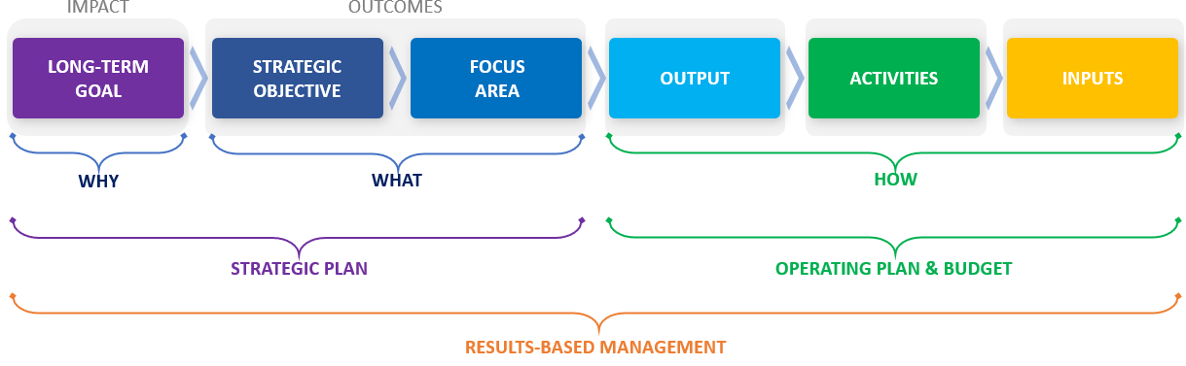
Results Based Management at WMO

Slide 7
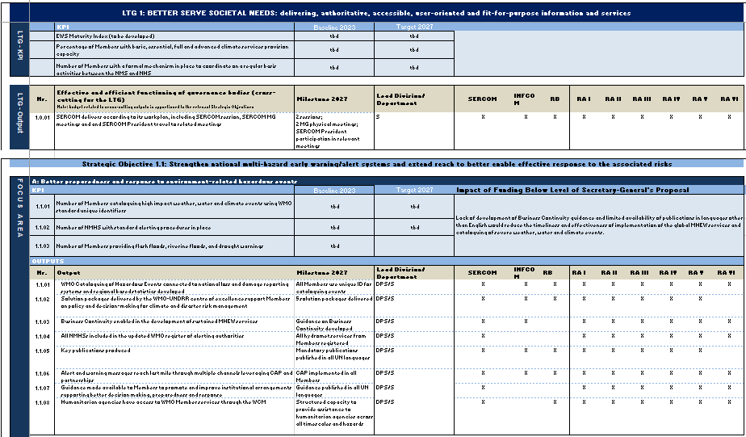
WMO Operating Plan 2024-2027
Presents the results chain
  LTG (impact) → SO (outcome) → Focus Area (intermediary outcome) → Output

Slide 8
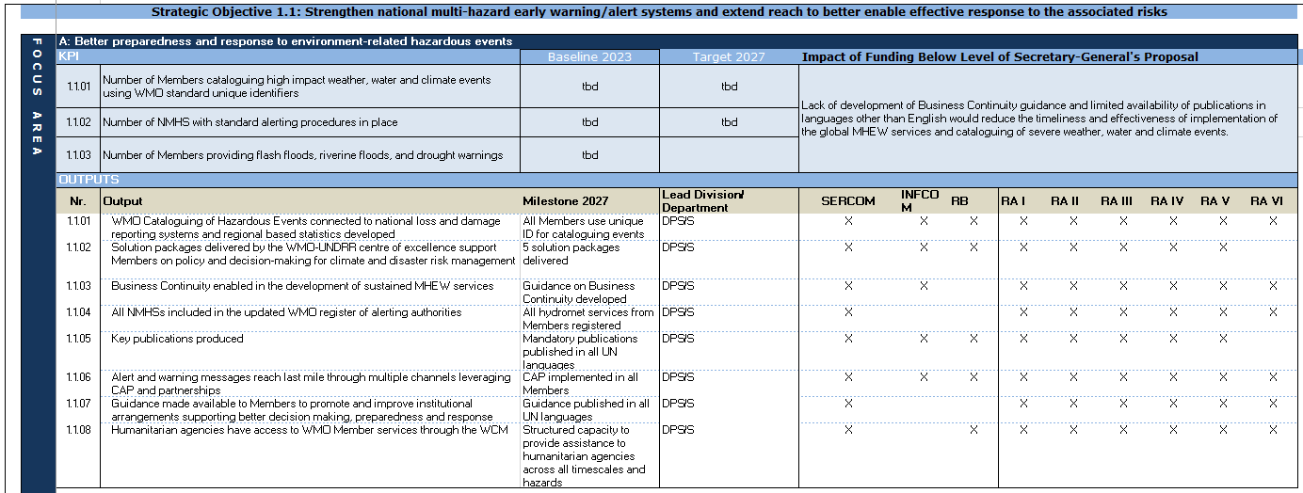
Presents the metrics
  Key Performance Indicators (at strategic level)
  Milestones (at operational level)
WMO Operating Plan 2024-2027

Slide 9
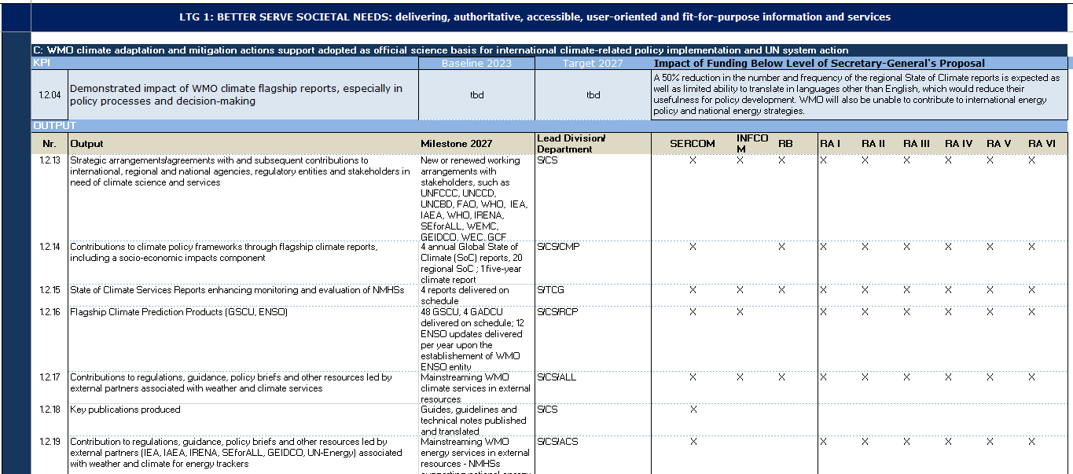
WMO Operating Plan 2024-2027
Identifies the governance bodies expected to contribute to implementation
  Integrated planning
  Use as a basis for TC/RB/RA work programmes

Slide 10
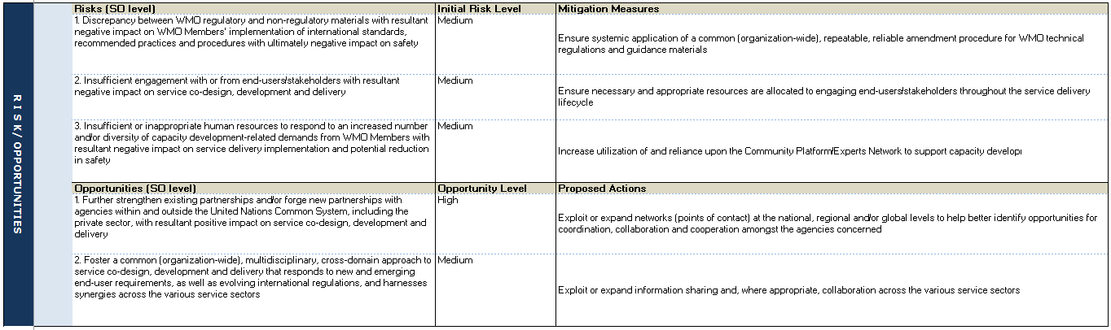
WMO Operating Plan 2024-27
Integrated risk management into planning
  Integrated planning
  Use as a basis for TC/RB/RA work programmes
Integrated risk management into planning
  Risks identified and assessed at SO level + mitigation measures defined
  Opportunities identified + proposed actions formulated

Slide 11
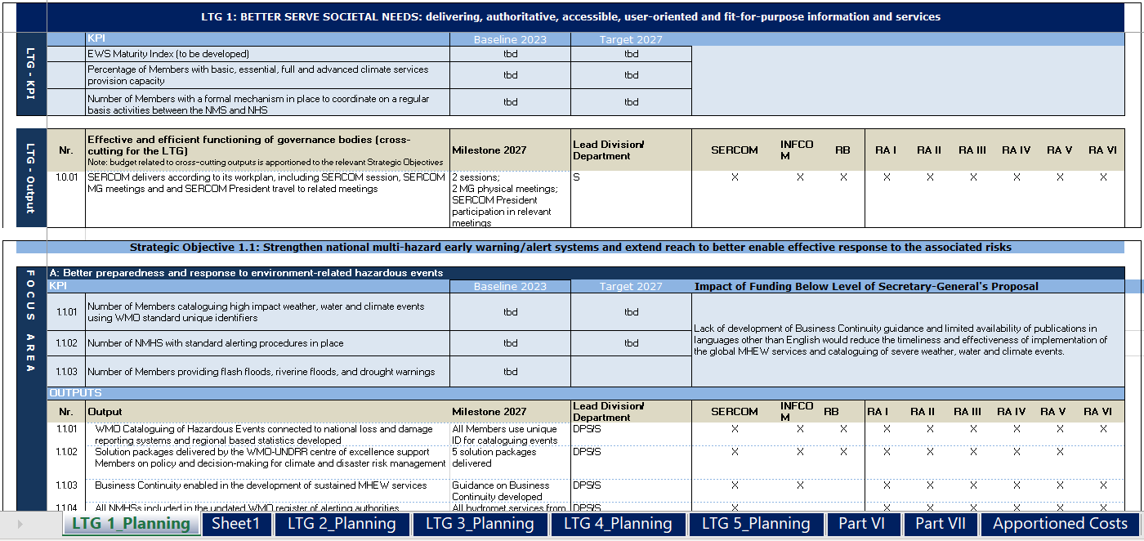
WMO Operating Plan 2024-27
Integrated risk management into planning
  Integrated planning
  Use as a basis for TC/RB/RA work programmes
For the first time outputs and milestones defined for Secretariat’s support to:
  Policy-making organs (Part VI)
  Language services (Part VII)
  Administration (indirect apportioned costs)

Slide 12
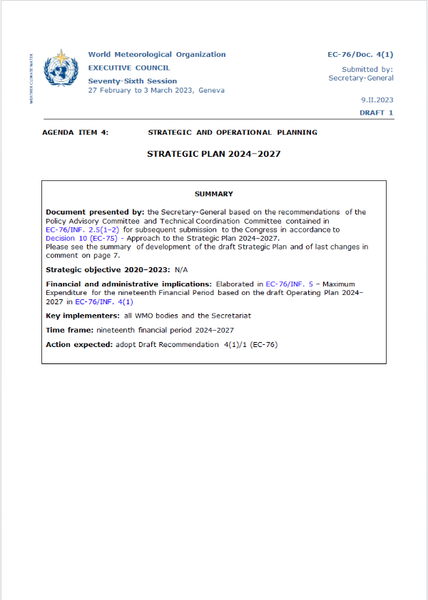
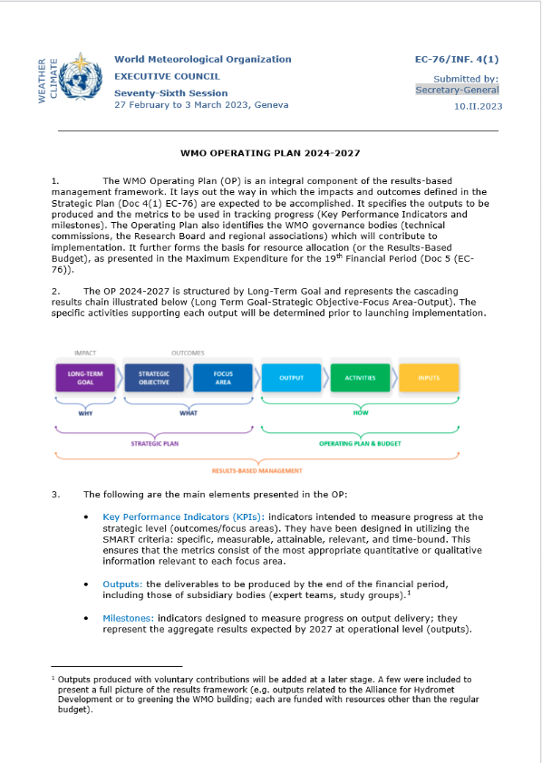
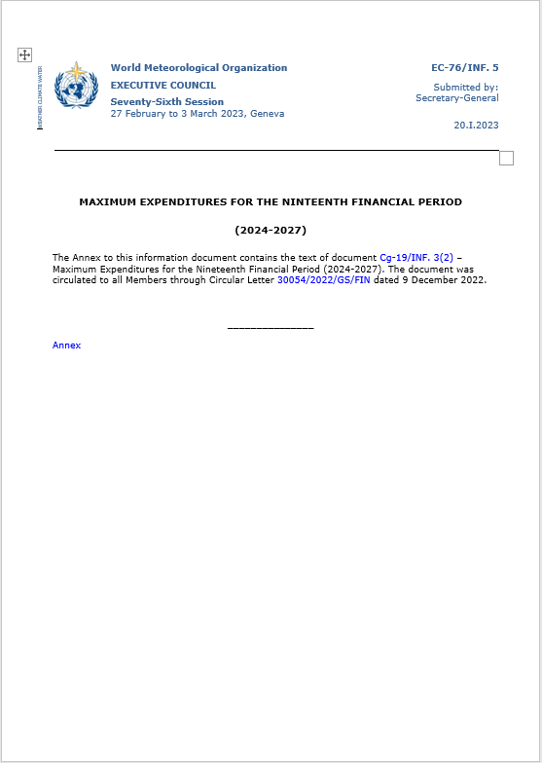
Alignment with the Strategic and Operating Plan
Strategic Plan 2024-2027
Operating Plan 2024-2027
Maximum Expenditures

Slide 13
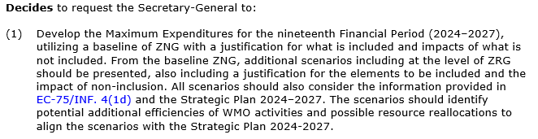
EC-75 Decision 11

Slide 14
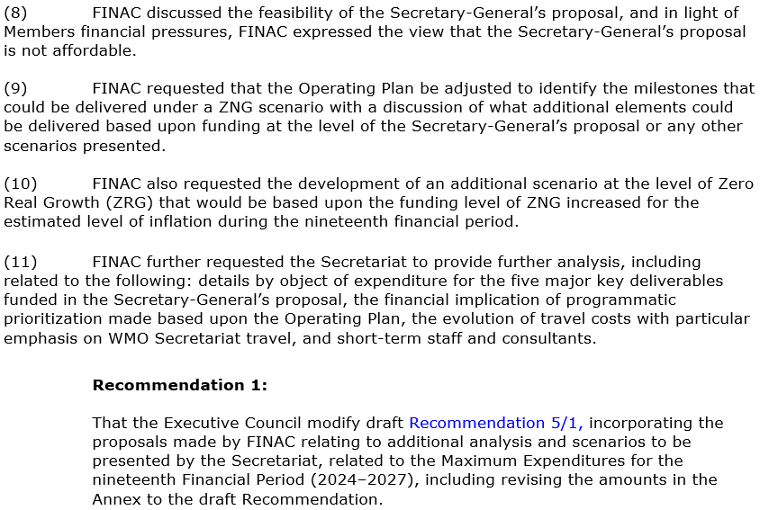
Report of FINAC-42

Slide 15
Maximum Expenditure Scenarios Presented
Background:
In line with Decision 11 (EC-75), the Secretary-General prepared two maximum expenditures scenarios.
  Secretary-General’s Proposal – Moderate Growth
  Zero Nominal Growth (ZNG) Scenario
Both scenarios:
  Are fully aligned with the Strategic Plan and Operating Plan
  Consider the financial constraints on Members
  Incorporate inflationary estimates as an explicit factor
  Incorporate potential additional efficiencies as explicit elements

Slide 16
Factors Common to both Scenarios

Slide 17
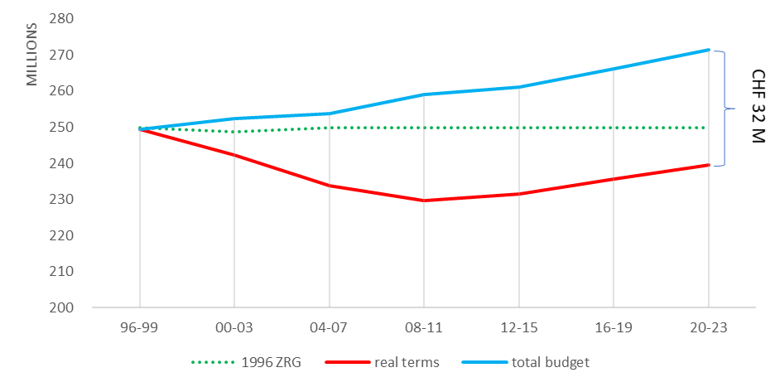
Historical Inflation
Impact of Inflation 1996 – 2023:

Slide 18
Basis for Inflation Estimates
Utilize International Monetary Fund (IMF) forecast:
IMF is internationally recognized
Utilizing forecast for all of Switzerland
Most recent update was published in October 2022
Long-term forecast, currently through 2027
IMF to update again in April 2023
Currently estimated to be approximately 2% over the full financial period
Inflation has NOT been calculated on certain non-staff costs (e.g. repayment of the loan) as they are not impacted by inflation
Energy cost increase separately estimated
Based upon current futures markets data in Europe
Limited data beyond 2024
Potential for fluctuations between forecast and actual amounts

Slide 19
Inflationary Impact by Scenario
Component | Estimated Impact – SG’s Proposal | Estimated Impact – ZNG Scenario
Staff Cost Inflation | CHF 4.5 million | CHF 4.3 million
Non-Staff Cost Inflation | CHF 1.4 million | CHF 1.2 million
Energy Costs | CHF 0.9 million | CHF 0.9 million
Total Impact | CHF 6.8 million | CHF 6.4 million

Slide 20



Economies and Efficiencies
Efficiencies were realized in the 18th Financial Period through:
These efficiencies were reinvested during the Financial Period through:
Investment in mid-level Professional Staff with knowledge in critical areas
Contributions to regional activities, primarily through the creation and filling of seven additional positions in Regional Offices

Slide 21

Economies and Efficiencies
Additional efficiencies planned for the 19th Financial Period:
Rationalization of Indirect Costs – CHF 3.8 million
  Reviewed administrative services support to extrabudgetary activities
  Reassignment of costs to be funded by Programme Support Cost Special Account (rather than Regular Budget)
Additional administrative savings – CHF 2.0 million
  Additional reprofiling of administrative positions toward programmatic activities

Slide 22
Secretary-General’s Proposal
Includes funding for ongoing WMO activities and limited funding for key additional requirements and priorities
Moderate increase over real growth
Proposal of CHF 290,396,400 represents an increase of 6.9% over ZNG
Operating Plan includes KPIs, Outputs and Milestones of what can be delivered within each Focus Area of each Strategic Objective under the Secretary-General’s Proposal

Slide 23
Secretary-General’s Proposal
Major Key Deliverables funded under Secretary-General’s Proposal:
Deliverable | LTGs addressed | Incremental funding requested
Early Warning Systems for All implemented by 2027 | LTGs 1–5, Part VI | CHF 5.5 million
Implementation of Global Greenhouse Gas Monitoring Infrastructure | LTGs 2–4 | CHF 2.5 million
Reorganization and optimization of the effectiveness of the WMO Regional and Representative Offices | LTG 4, LTGs 1–3 | CHF 3.5 million
Implementation of the Plan of Action for Hydrology | LTG 1 | CHF 1.2 million
Implementation of outputs associated with changes in the cryosphere and downstream impacts on water resources and sea level rise | LTG 1 | CHF 1.0 million
Total Major Key Deliverables |  | CHF 13.7 million

Slide 24
Secretary-General’s Proposal
Key Enabling Activities incorporated within the Secretary-General’s Proposal:
Deliverable | Incremental funding requested
Investment in modern and efficient ERP System | CHF 2.0 million
Implementation of the IT Strategy to improve security, efficiency and effectiveness of the IT environment | CHF 1.5 million
Investments in the WMO Headquarters Building | -
Total Key Enabling Activities | CHF 3.5 million

Slide 25
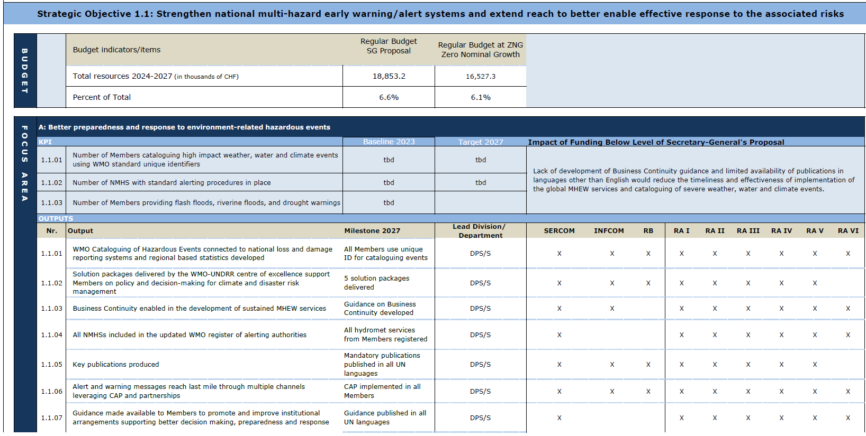
Secretary-General’s Proposal
Details from Operating Plan supporting Secretary-General’s Proposal:

Slide 26
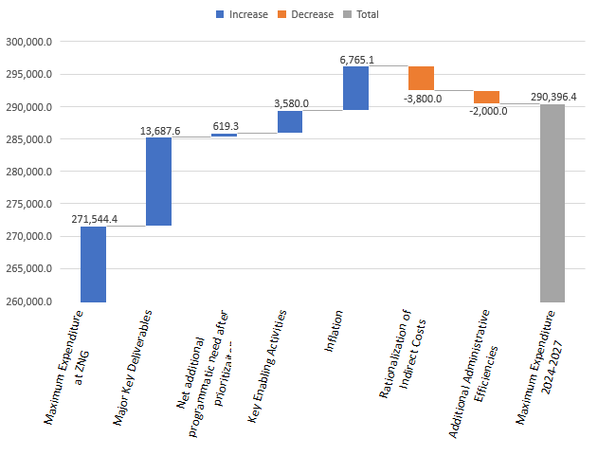
Secretary-General’s Proposal – Summary Components

Slide 27
Secretary-General’s Proposal
The resulting maximum expenditures by Long-Term Goal under the Secretary-General’s proposal is as follows:

Slide 28
Zero Nominal Growth (ZNG) Scenario
Maintains funding at CHF 271,544,400 for the financial period
Severely restricted ability to fund key additional deliverables
Prioritization of resources required to absorb the estimated impact of inflation
Operating Plan includes, for each Focus Area of each Strategic Objective, the impact of funding at levels below the Secretary-General’s Proposal:
  Includes discussion of the impact of reduced funding even if there is limited difference between Secretary-General’s Proposal and ZNG Scenario
  Supports prioritization of funding allocation by Members

Slide 29
Zero Nominal Growth (ZNG) Scenario
Reduced funding of Major Key Deliverables under ZNG Scenario:
Deliverable | Reduced funding under ZNG | Impact of Reduced Funding
Early Warning Systems for All implemented by 2027 | (CHF 3.2 million) | Commitment to EWS for All by 2027 will not be reached, thus impacting the lives and livelihood of the global community, particularly with respect to the last mile in LDCs and SIDS.
Implementation of Global Greenhouse Gas Monitoring Infrastructure | (CHF 2.5 million) | WMO implementation on the Coordinated Global Greenhouse Gas Monitoring Infrastructure will not be implemented; thus, delaying coordinated global action on this critical initiative and reducing WMO's impact and influence with respect to monitoring and mitigation of Global Greenhouse Gas levels.
Reorganization and optimization of the effectiveness of the WMO Regional and Representative Offices | (CHF 3.5 million) | Improvements to the effectiveness of the regional offices and their support to Members and Regional Associations would not be implemented. This would have a detrimental impact on all WMO programmes.
Implementation of the Plan of Action for Hydrology | (CHF 1.2 million) | Plan of Action for Hydrology, as approved at Cg-Ext (2021) will be delayed resulting in the non-delivery of critical hydrology-focused outputs as there would be insufficient human resources to manage their implementation.
Implementation of outputs associated with changes in the cryosphere and downstream impacts on water resources and sea level rise | (CHF 1.0 million) | Lack of policy developments to adequately address the emerging risks related to cryosphere and downstream impacts on water resources and sea level rise with significant reduction on the ability of the WMO community to support EWS for all.
Total Major Key Deliverables | (CHF 11.4 million)

Slide 30
Zero Nominal Growth (ZNG) Scenario
Details from Operating Plan supporting Secretary-General’s Proposal:

Slide 31
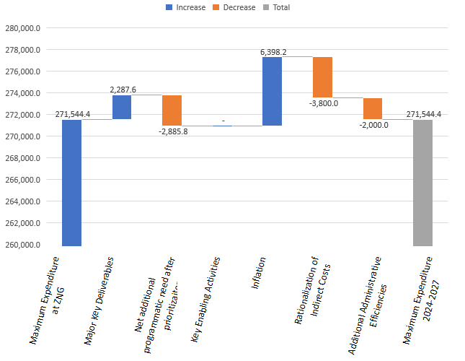
Zero Nominal Growth (ZNG) Scenario – Summary Components

Slide 32
Zero Nominal Growth (ZNG) Scenario
The resulting maximum expenditures by Appropriation Part under the ZNG Scenario is as follows:

Slide 33
Comparison of Elements within the Scenarios
Element | Secretary-General’s Proposal | ZNG Scenario | Variance
Maximum Expenditure at ZNG 2024-2027 | 271,544.4 | 271,544.4 | -
Major Key Deliverables | 13,687.6 | 2,287.6 | (11,400.0)
Net Additional Programmatic need after prioritization | 619.3 | (2,885.8) | (3,505.1)
Key Enabling Activities | 3,580.0 | - | (3,580.0)
Inflation | 6,765.1 | 6,398.2 | (366.9)
Rationalization of Indirect Costs | (3,800.0) | (3,800.0) | -
Additional Administrative Efficiencies | (2,000.0) | (2,000.0) | -
Maximum Expenditure Scenario 2024-2027 | 290,396.4 | 271,544.4 | (18,852.0)

Slide 34
Apportioned Cost within the Scenarios
Apportioned Costs | Secretary-General’s Proposal | ZNG Scenario | Variance
Legal and Administrative Costs | 21,512.6 | 21,512.6 | -
IT Operating and management costs | 16,564.8 | 12,984.8 | 3,580.0
Building Operations and management costs | 11,166.6 | 11,166.6 | -
Repayment of building loan | 5,909.2 | 5,909.2 | -
Total Apportioned Costs | 55,153.2 | 51,573.2 | 3,580.0
Apportioned Costs as % of Scenario | 19.0% | 19.0%
The apportioned costs are allocated to each of the Appropriation Parts as they support the implementation of the Appropriation Parts

Slide 35
View of Scenarios by Object of Expenditure
Object of Expenditure | SG’s Proposal (in %) | ZNG Scenario (in %)
Staff costs | 72.0% | 73.7%
Short-term staff and consultancy service | 5.0% | 4.5%
Travel – Experts | 6.5% | 5.9%
Travel - Staff | 1.6% | 1.6%
Fellowships and training activities | 1.0% | 1.0%
Grants and financial contributions | 2.0% | 1.9%
Contractual services and operating expenses | 9.9% | 9.2%
Repayment of the loan for WMO HQ building | 2.0% | 2.2%
Total by Object of Expenditure | 100.0% | 100.0%
INSERT TABLE OF RESULTS
WORK IN PROGRESS

Slide 36
Expenditure Trends in the 18th Financial Period
Expenditures and operations during the second biennium (2022-2023) of 18th Financial Period increasing. Planned near full spend of available funds, including unspent funds from 2020-2021:
Travel and other operations increasing since mid-2022 as COVID-19 pandemic restrictions were reduced
Inflationary impacts, particularly on energy, impacting expenditures
Unspent funds from 2020-2021 approved for re-utilization by EC-73
  Being utilized for deferred programmatic activities and growing demands on WMO
  Supporting critical investment needs (e.g. Headquarters Building, ERP upgrade, Regional Office IT infrastructure)
Final elements of Secretariat reorganization
  Reinvestment in technical staff from generated administrative staff costs savings was mostly completed in 2022

Slide 37
2022 Regular Budget Implementation
2022 incurred spend in excess of 2022 budget due to unspent funds from 2020-2021 biennium

Slide 38
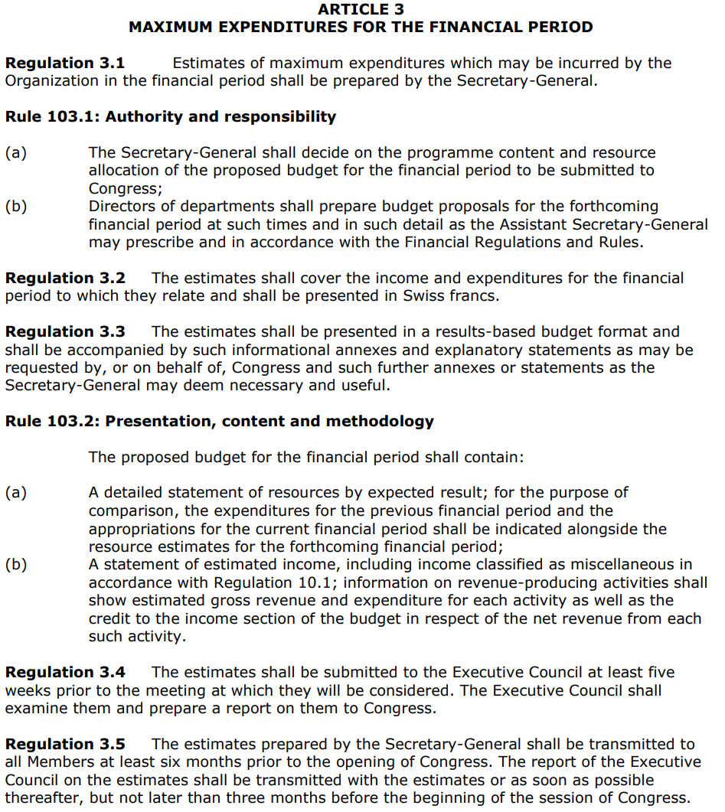
EC Role in Maximum Expenditures Review
EC examines the maximum expenditure estimates prepared by the Secretary-General and reports to Congress

Slide 39
Roadmap for Maximum Expenditures Approval
Publishing
Update Max Expenditures
Draft Cg-19 resolution, Cg-19 INF
Draft EC-76 Rec., EC INF
Draft Cg-19 resolution, Cg-19 INF
Final EC-76 Rec.
03
Congress-19
07
Approved Resolution on maximum expenditure 2024-2027
PAC
EC-76
EC-75
Review SP and Draft
Cg Documents
Deliberation of Strategic Plan
Recommendation to Cg-19
09
02
04
06
FINAC-41
FINAC-42
Deliberation by FINAC and guidance to Secretariat
Report to EC-76
FINAC-43
Update of EC-76 recommendation
Report to Cg-19
01
05
08
Jun
Jul
Aug
Sep
Oct
Nov
Dec
Jan
Feb
Mar
Apr
May
Jun
Q2
2022
|
2023

Slide 40
Remaining Process – Max Expenditures 2024-2027
EC-76 (February 2023)
  Budget Committee to meet during EC-76 to update EC Recommendation to Congress
Cg-19 (May 2023)
  Presentation and discussion at FINAC-43
  Cg-19 budget subcommittee considers and provides additional guidance
  Approval by Cg-19
EC-77 (June 2023)
  Considers and approves Budget 2024-2025, in line with Cg-19 decision

Slide 41
Maximum Expenditures 2024-2027 – Draft EC Recommendation
Draft Recommendation 5/1 (EC-76)
Recommends to Congress the adoption of draft Resolution ##/1 (Cg-19) provided in the annex to the present Recommendation.
Annex to Draft Recommendation 5/1 (EC-76) – Draft Resolution ##/1 (Cg-19)
Authorizes the Executive Council during the nineteenth financial period from 1 January 2024 to 31 December 2027:
(1) To incur maximum expenditures of XXX XXX XXX Swiss francs [to be decided by Congress] to be funded through assessed contributions;
(2) To distribute the regular budget resources by appropriation part as provided in the annex to this resolution;
(3) To approve the biennial appropriations for 2024–2025 and for 2026–2027 within these limits;
Further authorizes the Executive Council to incur other expenditure from voluntary resources contributing to enhanced implementation of programme activities in line with the Strategic Plan, including co-sponsored programmes and initiatives;
Requests the Secretary-General to monitor the implementation of the Operating Plan at both the outcome and output levels, in accordance with the WMO monitoring and evaluation system, in particular in relation to the use of budgetary resources;
Invites Members to consider contributing voluntary resources to accelerate, expand and/or scale up the implementation of the Long-term Goals and Strategic Objectives of the Strategic Plan for 2024–2027.

